Slide 1
Weather Detection System Based On Single Image
Group Member

Slide 2
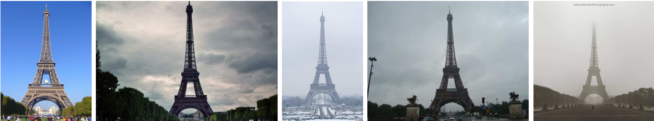
Tasks
NETWORK
Sunny Cloudy Snowy Rainy Foggy

Slide 3

Image2Weather Dataset
$$9.25°W−30.4°E,35°N−62.21°N$$
(covering most part of the Europe)
Number of sunny images | 70,501
Number of cloudy images | 45,662
Number of snowy images | 1,252
Number of rainy images | 1,369
Number of foggy images | 357
Number of other images | 64,657
Total | 183,798
Chu W T , Zheng X Y , Ding D S . Image2Weather: A Large-Scale Image Dataset for Weather Property Estimation[C]// 2016 IEEE Second International Conference on Multimedia Big Data (BigMM). IEEE, 2016.

Slide 4
Related Work
Classification can only distinguish “sunny” and “cloudy”.
Need some meteorological information (temperature, humidity).
 | SVM | Adaboost | Collaborative Learning[1] | ResNet-50[2]
Normalized accuracy | 41.2 ± 2.2 | 36.4 ± 2.3 | 53.1 ± 2.2 | 65.75 ± 2.1
[1]Lu C , Lin D , Jia J , et al. Two-Class Weather Classification[C]// 2014 IEEE Conference on Computer Vision and Pattern Recognition (CVPR). IEEE, 2014.
[2]Chen B C , Ghosh P , Morariu V I , et al. Detection of Metadata Tampering Through Discrepancy Between Image Content and Metadata Using Multi-task Deep Learning[C]// 2017 IEEE Conference on Computer Vision and Pattern Recognition Workshops (CVPRW). IEEE, 2017.

Slide 5
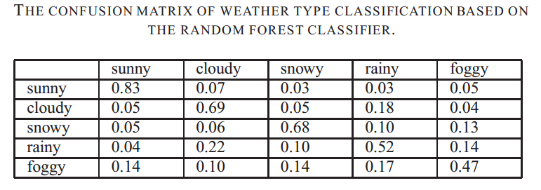
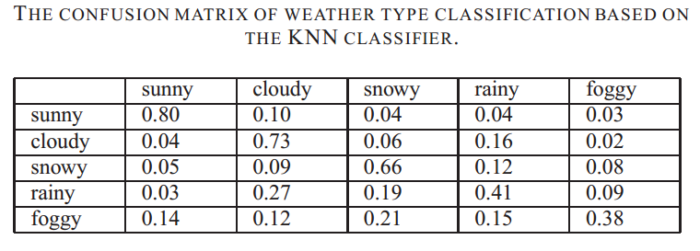
Related Work Based on Image2Weather Dataset

Slide 6
Network Structure
Densenet-169 (pretrain)
+
A shallow Neural Network
Loss function: Cross Entropy Loss

Slide 7
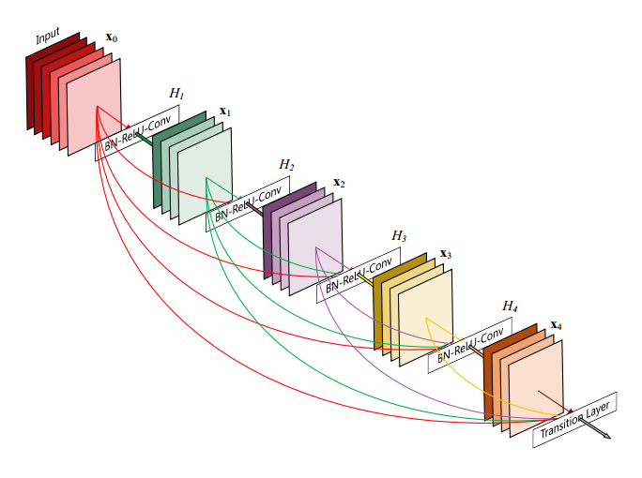
Network Architecture
Densely Connected Convolutional Networks
Huang G , Liu Z , Maaten L V D , et al. Densely Connected Convolutional Networks[C]// 2017 IEEE Conference on Computer Vision and Pattern Recognition (CVPR). IEEE Computer Society, 2017.

Slide 8
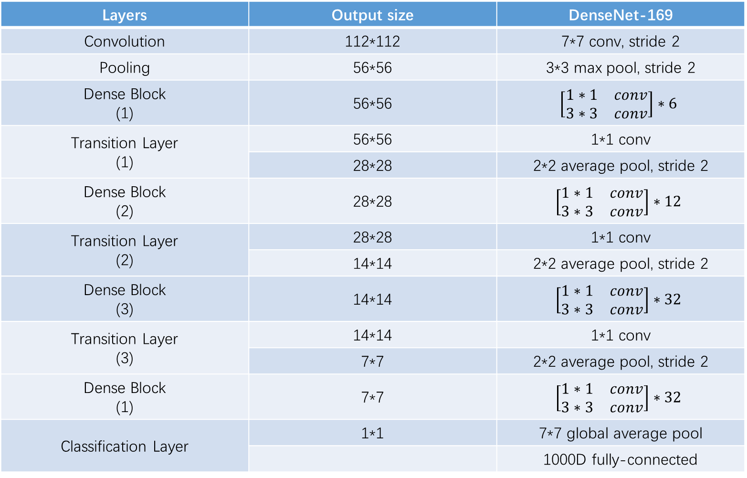
Layers | Output size | DenseNet-169
Convolution | 112*112 | 7*7 conv, stride 2
Pooling | 56*56 | 3*3 max pool, stride 2
Dense Block (1) | 56*56 | $$\left[\begin{matrix}1∗1 & conv \\ 3∗3 & conv\end{matrix}\right]∗6$$
Transition Layer (1) | 56*56 | 1*1 conv
 | 28*28 | 2*2 average pool, stride 2
Dense Block (2) | 28*28 | $$\left[\begin{matrix}1∗1 & conv \\ 3∗3 & conv\end{matrix}\right]∗12$$
Transition Layer (2) | 28*28 | 1*1 conv
 | 14*14 | 2*2 average pool, stride 2
Dense Block (3) | 14*14 | $$\left[\begin{matrix}1∗1 & conv \\ 3∗3 & conv\end{matrix}\right]∗32$$
Transition Layer (3) | 14*14 | 1*1 conv
 | 7*7 | 2*2 average pool, stride 2
Dense Block (1) | 7*7 | $$\left[\begin{matrix}1∗1 & conv \\ 3∗3 & conv\end{matrix}\right]∗32$$
Classification Layer | 1*1 | 7*7 global average pool
 |  | 1000D fully-connected

Slide 9
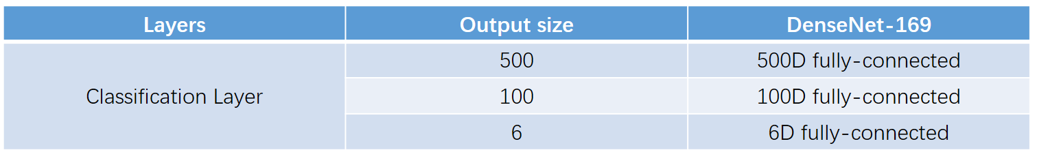

Slide 10
Some tricks
Data pre-proposing:
Random Crop
Random Horizontal Flip
Normalize
Batch Normalize
Pretain
Adam (learning rate=1e-3)

Slide 11
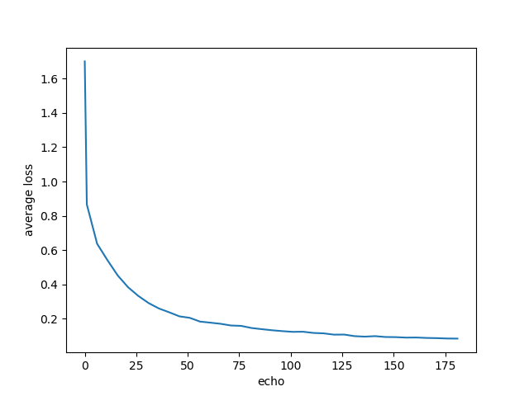
Experiment result (Train set takes 75% of the selected data set. )
Each class | Cloudy | Foggy | Rain | Snow | Sunny | Z-other
Normalized accuracy | 67.54 | 40.62 | 33.23 | 46.25 | 81.11 | 73.76

Slide 12
Experiment result (Test set takes 25% of the select data set. )
 | Cloudy | Foggy | Rain | Snow | Sunny | Z-other
Cloudy | 67.79 | 0.09 | 0.19 | 0.12 | 14.40 | 17.41
Foggy | 11.48 | 42.58 | 0.00 | 0.56 | 7.28 | 38.10
Rain | 20.31 | 0.292 | 33.52 | 0.22 | 9.42 | 36.23
Snow | 6.31 | 0.16 | 0.16 | 48.48 | 10.78 | 34.11
Sunny | 6.88 | 0.02 | 0.06 | 0.06 | 81.18 | 11.81
Z-other | 10.08 | 0.07 | 0.16 | 0.20 | 15.46 | 74.00

Slide 13
Result Analysis
Z-other class
 | Cloudy | Foggy | Rain | Snow | Sunny | Z-other
Cloudy | 67.79 | 0.09 | 0.19 | 0.12 | 14.40 | 17.41
Foggy | 11.48 | 42.58 | 0.00 | 0.56 | 7.28 | 38.10
Rain | 20.31 | 0.292 | 33.52 | 0.22 | 9.42 | 36.23
Snow | 6.31 | 0.16 | 0.16 | 48.48 | 10.78 | 34.11
Sunny | 6.88 | 0.02 | 0.06 | 0.06 | 81.18 | 11.81
Z-other | 10.08 | 0.07 | 0.16 | 0.20 | 15.46 | 74.00

Slide 14
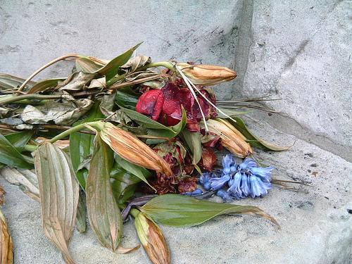
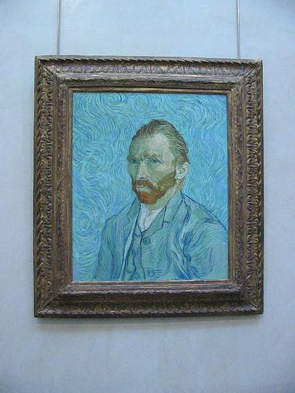
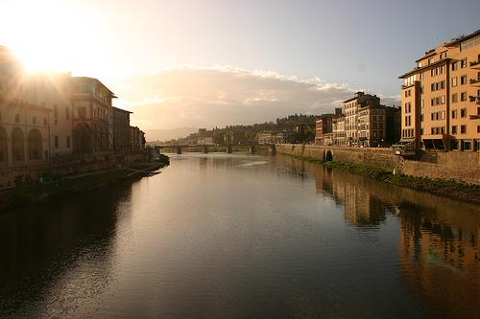
Result Analysis
Z-other class
(something that it is hard even for human to classify,
something that should be put in other class)

Slide 15
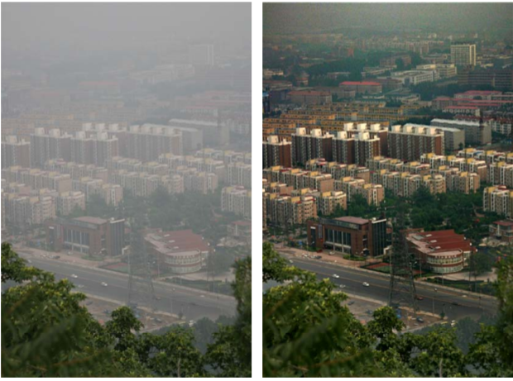
Something further to do
Haze removal
Snowflakes, raindrop removal
Tang X . Single Image Haze Removal Using Dark Channel Prior[C]// 2009 IEEE Conference on Computer Vision and Pattern Recognition. IEEE, 2009.

Slide 16
THANKS FOR LISTENING

